Slide 1

Inbuilt Sort() Function
Presented by:
Samarth Agarwal
Mohit Soni
Mohit Bharti

Slide 2
Content
Introduction to STL and sort()
Internal structure of sort()
Insertion sort
Heap sort
Quick sort

Slide 3
Introduction to STL and Sort()
The Standard Template Library (STL) is a set of C++ template classes to provide common programming data structures and functions such as lists, stacks, vectors, etc. It is a library of container classes, algorithms, and iterators.
Sorting is one of the most basic functions applied to data. It means arranging the data in a particular fashion, which can be increasing or decreasing. There is a built-in function in C++ STL by the name of sort().

Slide 4
Syntax
Sort (startaddress, endaddress, comparator)
where:
startaddress: the address of the first element of the array
endaddress: the address of the last element of the array
comparator: the comparison to be done with the array.
This argument is optional.

Slide 5
Internal structure of Sort()
This function internally uses IntroSort. In more details it is implemented using hybrid of QuickSort, HeapSort and InsertionSort.By default, it uses QuickSort but if QuickSort is doing unfair partitioning and taking more than N*logN time, it switches to HeapSort and when the array size becomes really small, it switches to Insertion Sort.
Time Complexity
Best Case – O(N log N)
Average Case- O(N log N)
Worse Case- O(N log N)

Slide 6
Insertion Sort()
It is a simple sorting algorithm which sorts the array by shifting elements one by one.
Following are some important characteristics of Insertion Sort() :
It has one of the simplest implementation.
It is efficient for smaller data sets, but very inefficient for large data sets.
It is inplace sorting for iterative approach, but for recursive, we have to use a stack, so it causes O(N) space complexity.
Its worst case time complexity is : O(N^2)

Slide 7
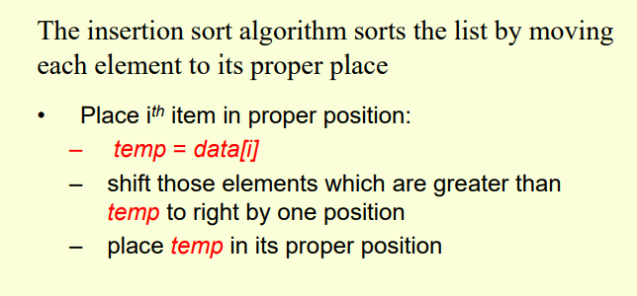
Algorithm

Slide 8
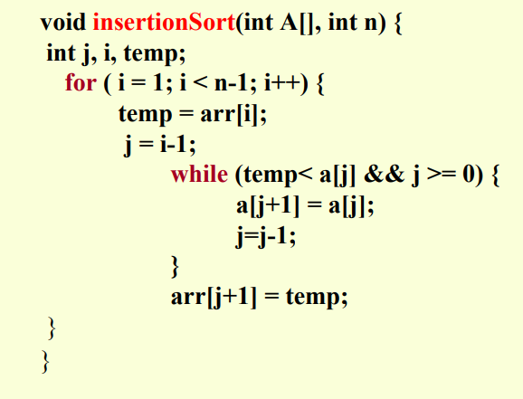

Slide 9
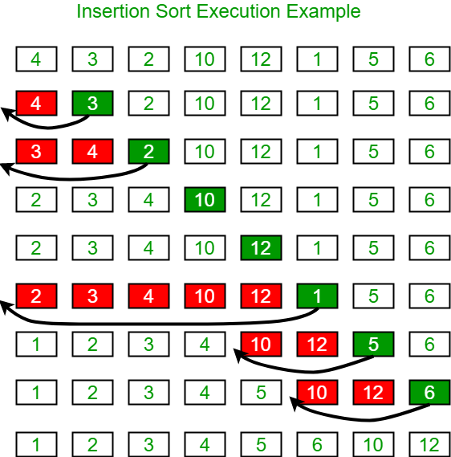

Slide 10
Heap Sort
Heap sort is a comparison based sorting technique based on Binary Heap data structure. It is similar to selection sort where we first find the maximum element and place the maximum element at the end. We repeat the same process for remaining element.
A Binary Heap is a Complete Binary Tree where items are stored in a special order such that value in a parent node is greater(or smaller) than the values in its two children nodes. The former is called as max heap and the latter is called min heap. The heap can be represented by binary tree or array.

Slide 11
Why array based representation for Binary Heap?
Since a Binary Heap is a Complete Binary Tree, it can be easily represented as array and array based representation is space efficient. If the parent node is stored at index I, the left child can be calculated by 2 * I + 1 and right child by 2 * I + 2 (assuming the indexing starts at 0).
Heap Sort Algorithm for sorting in increasing order:
1. Build a max heap from the input data.
2. At this point, the largest item is stored at the root of the heap. Replace it with the last item of the heap followed by reducing the size of heap by 1. Finally, heapify the root of tree.
3. Repeat above steps while size of heap is greater than 1.

Slide 12
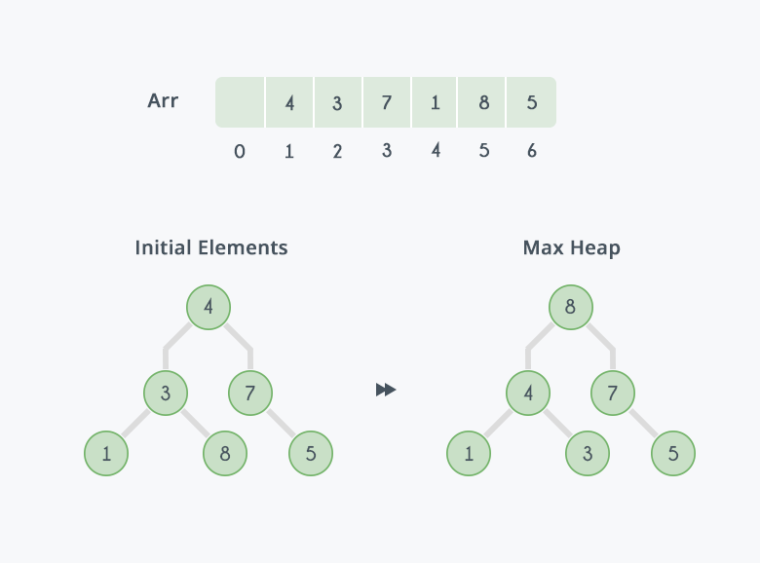
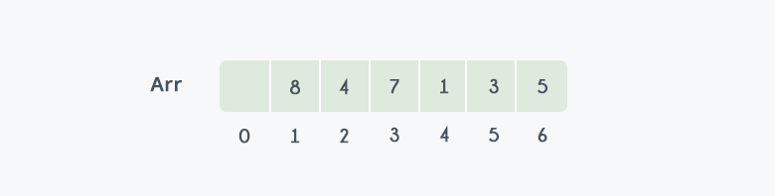
We have an unsorted array Arr having 6 elements and then max-heap will be built
After building max-heap, the elements in the array Arr will be:

Slide 13
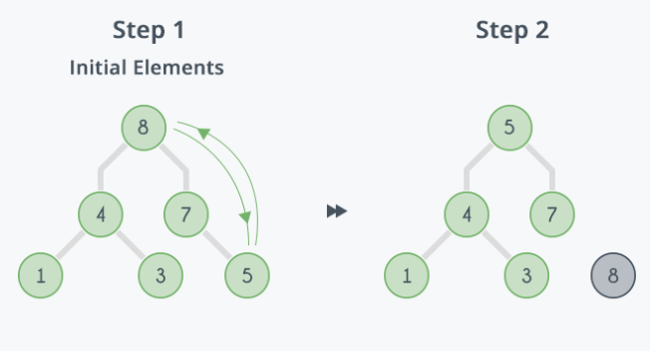
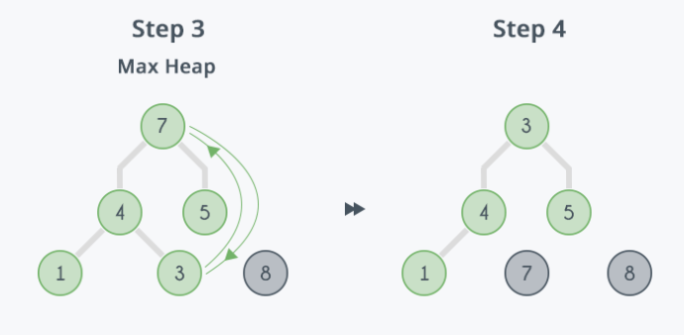
Step 1: 8 is swapped with 5.
Step 2: 8 is disconnected from heap as 8 is in correct position now
Step 3: Max-heap is created and 7 is swapped with 3.
Step 4: 7 is disconnected from heap.

Slide 14
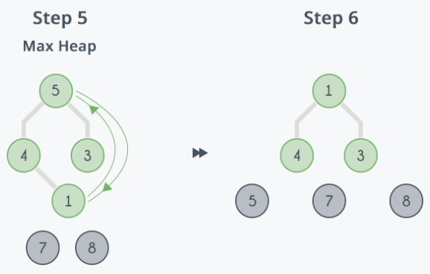
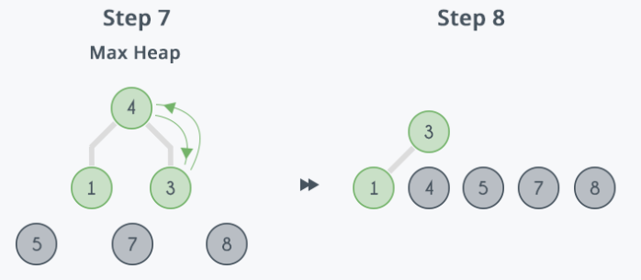
Step 5: Max heap is created and 5 is swapped with 1.
Step 6: 5 is disconnected from heap.
Step 7: Max heap is created and 4 is swapped with 3
.
Step 8: 4 is disconnected from heap.

Slide 15
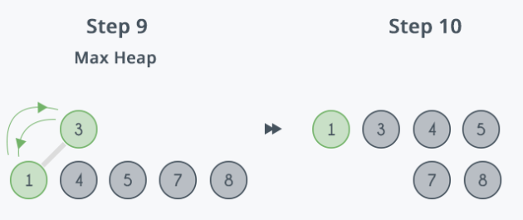
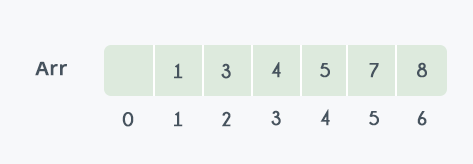
Step 9: Max heap is created and 3 is swapped with 1.
Step 10: 3 is disconnected.
After all the steps, we will get a sorted array.

Slide 16
Time Complexity: Time complexity of heapify is O(Logn). Time complexity of
createAndBuildHeap() is O(n) and overall time complexity of Heap Sort is O(nLogn).

Slide 17
Quick Sort
-> It is highly efficient algorithm with average time complexity of O(n log n).
->It is based on partitioning of array of data into smaller arrays.
-> Array is divided into two subarrays, one subarray contain values smaller than pivot (specified value) and another subarray contains value greater than pivot.
->Quicksort partition and then calls itself recursively twice to sort the two resulting subarrays.

Slide 18
Quick Sort Algorithm
Step 1 − Make the right-most index value pivot
Step 2 − partition the array using pivot value
Step 3 − quicksort left partition recursively
Step 4 − quicksort right partition recursively

Slide 19
Quick Sort Pivot Algorithm
Step 1 − Choose the highest index value as pivot
Step 2 − Take two variables to point left and right of the list excluding pivot
Step 3 − left points to the low index
Step 4 − right points to the high
Step 5 − while value at left is less than pivot move right
Step 6 − while value at right is greater than pivot move left
Step 7 − if both step 5 and step 6 does not match swap left and right
Step 8 − if left = right, then swap(arr[left],pivot).
Step 9 - The point where they met is position of new pivot

Slide 20
Quick Sort Example

Slide 21
Quick Sort Pseudo Code
procedure quickSort(left, right)
if right-left <= 0
return
else
pivot = A[right]
partition = partitionFunc(left, right, pivot)
quickSort(left,partition-1)
quickSort(partition+1,right)
end if
end procedure

Slide 22
Quick sort Pivot Pseudo Code
function partitionFunc(left, right, pivot)
leftPointer = left
rightPointer = right - 1
while True do
while A[++leftPointer] < pivot do
//do-nothing
end while
while rightPointer > 0 && A[--rightPointer] > pivot do
//do-nothing

Slide 23
end while
if leftPointer >= rightPointer
break
else
swap leftPointer,rightPointer
end if
end while
swap leftPointer,right
return leftPointer
end function

Slide 24


